Slide 1
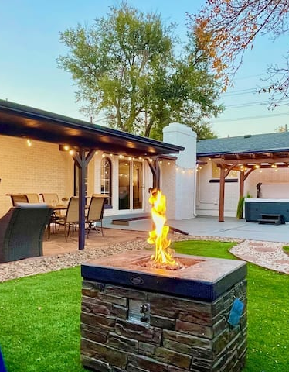
Hospitality Analysis

Slide 2





CONTENTS
Why Hospitality Analysis
Metrics
KPI’S
Dashboards Excel , power bi, Tableau
Conclusion

Slide 3

Why Hospitality Analysis ?
Data analytics in hospitality helps hoteliers make data driven decisions that boost efficiency. Use it to improve the customer experience and drive profitability by accurately Forecasting demand. It also gives your F&B department the necessary data to make optimal purchasing decisions.

Slide 4
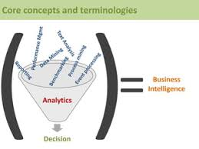
METRICS
Hotel Performance metrics are crucial for evaluating a hotel’s operational efficiency, financial performance, and guest satisfaction. Occupancy rate and ADR assess demand and pricing strategies, while RevPAR and TRevPAR offer a comprehensive view of revenue generation

Slide 5

KPI’s
Total Revenue
Occupancy
Cancellation Rate
Total Booking
Utilize Capacity
Trend Analysis
Weekday & Weekend revenue and bookings
Revenue by state & hotels
Class wise revenue
Checked out cancel no show
Weekly trend key trend
( Revenue, Total booking, occupancy

Slide 6
DASHBOARD
EXCEL
POWER BI
​ TABLEAU
Excel dashboard" is a visual representation of key data points and metrics designed to provide a concise overview of information for easy analysis and decision-making.
A Power BI dashboard is a dynamic and interactive platform for visualizing and analyzing data from multiple sources
A Tableau dashboard serves as a dynamic and visual representation of data, enabling users to gain insights and make informed decisions.

Slide 7
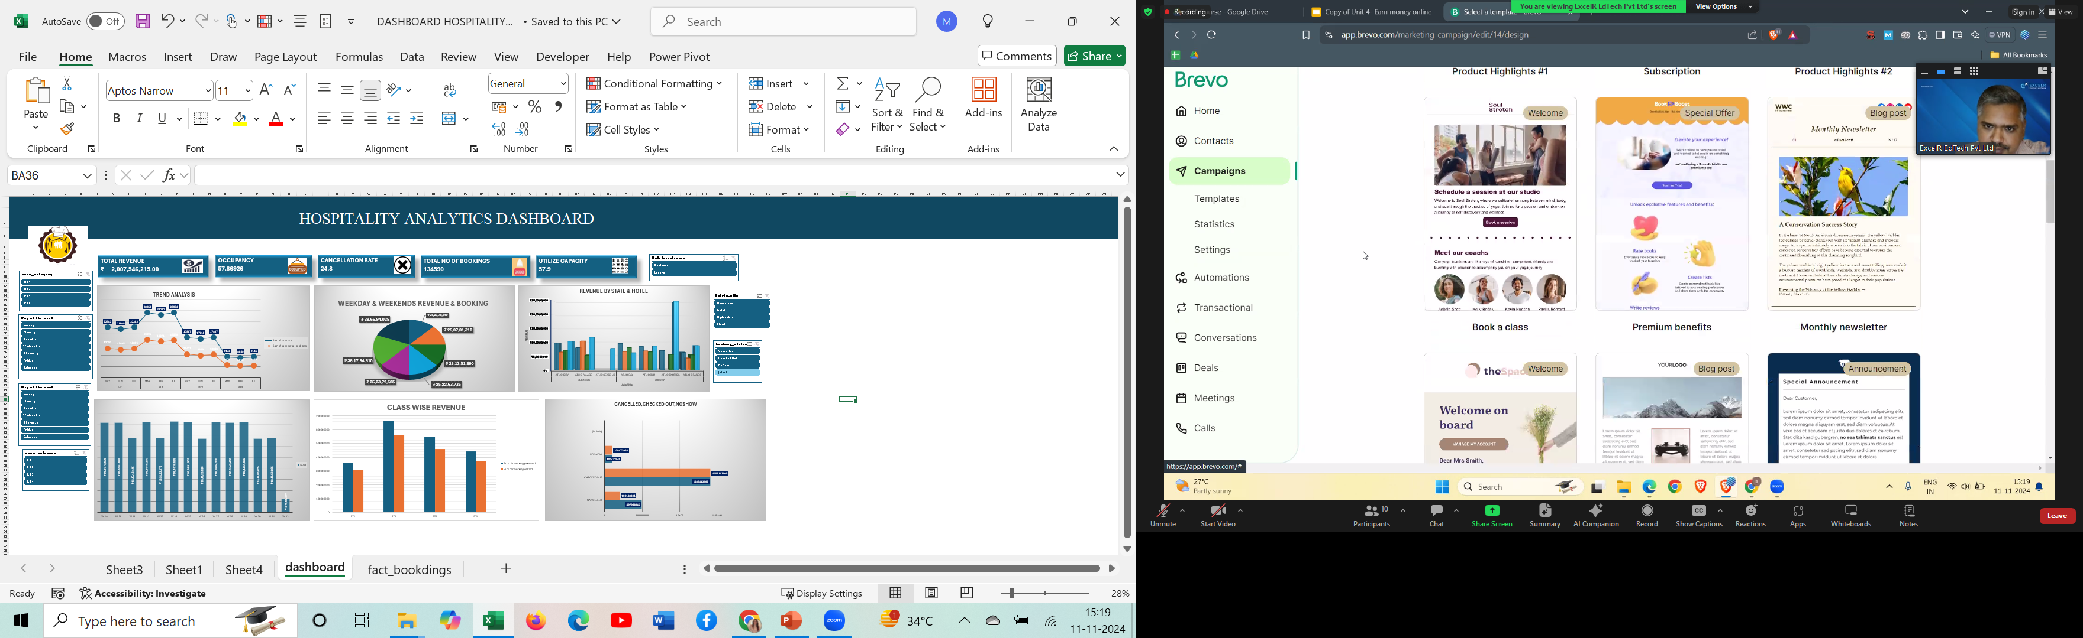
EXCEL DASHBOARD

Slide 8
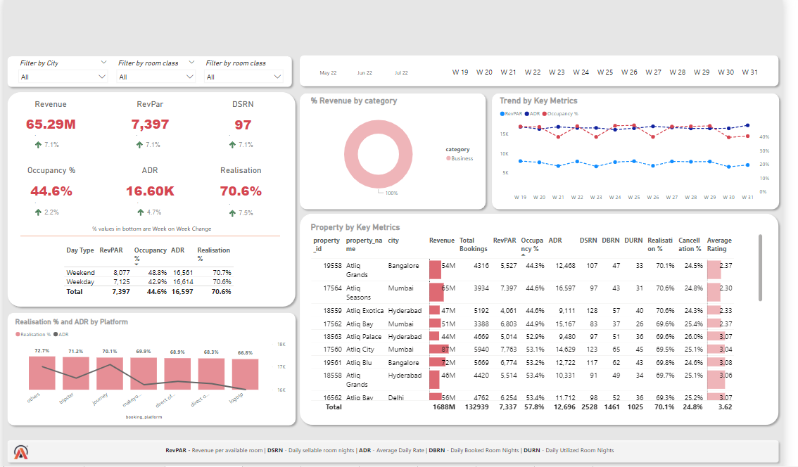
POWER BI DASHBOARD

Slide 9
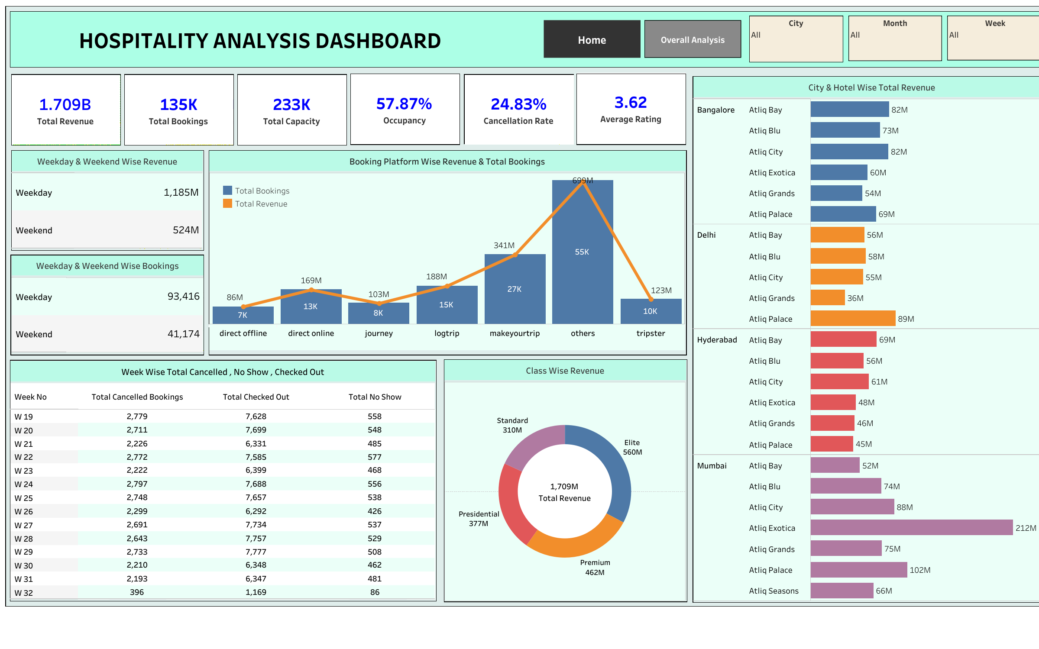
TABLEAU DASHBOARD

Slide 10
1.Delhi records the highest occupancy rate and the best ratings among all cities. 2.Mumbai generates the highest revenue.
3.In terms of guest numbers, Mumbai accommodates the largest number of visitors compared to other cities.
4.Guests predominantly prefer the Elite room type.
5.The property that brings in the highest revenue is Atliq Exotica.
6.The month of May sees the highest revenue generation.
7.Luxury rooms/suites are more favored by guests than Business rooms.
8.The property with the highest occupancy rate is Atliq Palace
CONCLUSION:-

Slide 11

Thank You

